Slide 1

MEDIA SURVIVAL ANALYSIS
WELCOME TO THE PRESENTATION ON
Domain – Media/Broadcasting
Function – Strategy

Slide 2
TABLE OF CONTENTS
Problem Statement
Project Objective
Data Sources and Methodologies
Key Findings & Insights
Recommendations

Slide 3
PROBLEM STATEMENT
Bharat Herald, a 70-year-old legacy newspaper operating across five Indian states, is facing an existential crisis. Print circulation has plunged from 1.2 million to under 560,000 (2019–2024), as mobile-first rivals like DigiHindi Post and InShorts captured digital audience's post-pandemic.
A failed 2021 e-paper pilot, marked by poor mobile UX and financial losses, eroded advertiser trust, delayed vendor payments, and led to bureau closures. With over 60 layoffs and a fiscal crisis revealed by internal audits, Bharat Herald must now embrace a data-driven digital strategy - or risk becoming obsolete.

Slide 4
PROJECT OBJECTIVE
To assess Bharat Herald’s operational and financial decline from 2019–2024, quantify key challenges - including print ad revenue loss and digital pilot failure - evaluate recovery opportunities in mobile and regional markets, and recommend a phased, data-driven roadmap for digital transformation.

Slide 5
DATA SOURCES & METHODOLOGIES
📊 Data Sources
6 CSV files of dim_ad_category, dim_city, fact_ad_revenue, fact_city_readiness, fact_digital_pilot and fact_print_sales.
⚙️ Methodology and Tools
Tools : Python, MySQL and Power BI
Techniques – Data cleaning, Visualizing key metrics, KPI tracking.

Slide 6
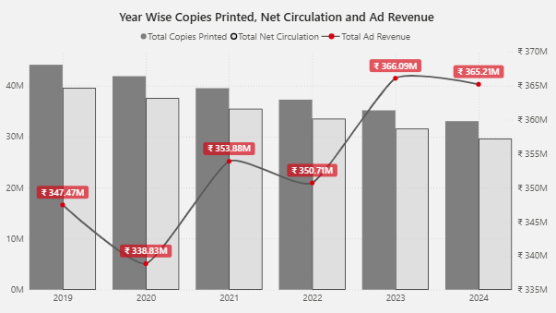
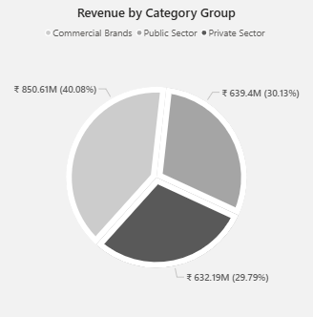
KEY FINDINGS / INSIGHTS
Despite a decline in copies printed and net circulation, advertising revenue continues to trend upward - a promising indicator of growing advertiser confidence.
Ad revenue is well-diversified, with nearly all categories contributing substantial shares.

Slide 7
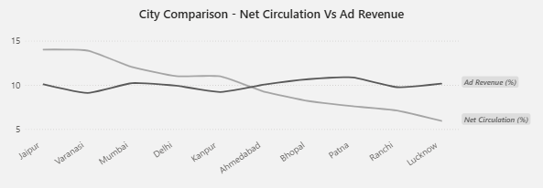
KEY FINDINGS / INSIGHTS
Some cities generated higher ad revenue despite lower net circulation. These high-performing cities should be prioritized to increase circulation and further maximize revenue potential.

Slide 8
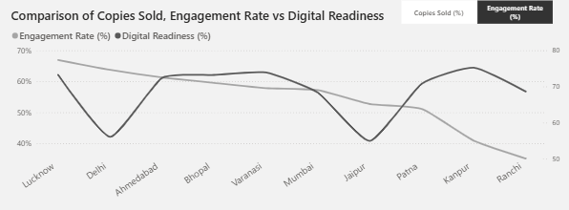
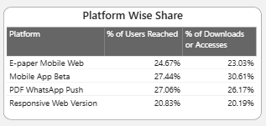
KEY FINDINGS / INSIGHTS
The 2021 digital pilot largely failed - while a few cities showed promise, most exhibited engagement rates below their digital readiness levels
By platform, the mobile app shows positive signs, reaching 27.44% of users with 30.61% accessing or downloading content, whereas engagement on other platforms remains below these levels.

Slide 9
RECOMMENDATIONS
Bharat Herald’s Phased Digital Transition Strategy
Expand & Monetize
(6-12 Months)
Innovate & Diversify
(12-24 Months)
Optimize & Stabilize
(0-6 Months)
Optimize and Stabilize – Enhance the existing digital infrastructure, focusing on mobile-first design, as Indians spend 82% of their time on entertainment and media apps (as per PwC). This period should also involve improving user experience and addressing technical issues.
Expand & Monetize – Gradually introduce subscription models after building trust through free access, aligning with emerging monetization strategies in India's digital businesses (as per Blume Ventures). This phase should focus on converting engaged users into paying subscribers.
Innovate & Diversify – Diversify content into various digital formats, such as podcasts, newsletters, and interactive media, to enhance customer experience and engagement. This approach aligns with trends in content diversification in the Indian media landscape.

Slide 10
RECOMMENDATIONS
Bharat Herald’s - Enhancing Digital Engagement
WhatsApp Integration - Develop a WhatsApp channel to deliver daily news summaries, leveraging its high engagement rates.
E-Paper Optimization - Redesign the e-paper interface to ensure compatibility with mobile devices, enhancing accessibility.
Content Diversification - Introduce multimedia content such as videos and podcasts to cater to diverse audience preferences.

Slide 11
RECOMMENDATIONS
Bharat Herald’s – Revenue Recovery
Subscription Bundling - Partner with telecom providers to offer bundled subscriptions, increasing reach and reducing customer acquisition costs.
Loyalty Program Launch - Introduce a tiered loyalty program that rewards subscribers with exclusive content, early access, and discounts, enhancing customer retention.
Pay-Per-Article Option - Implement a pay-per-article model for premium content, attracting occasional readers and generating additional revenue.

Slide 12
THANK YOU

